Slide 1
Chapter 8: Employment, Labor, and wages

Slide 2

Chapter 8
Macroeconomics – Branch of economics that deals with the economy as a whole
Civilian Labor Force – Men and women 16 years old and over who are either working or actively looking for work
Types of Unions
Craft Union or Trade Union – An association of skilled workers who perform the same kind of work
Industrial Union – An association of all workers in the same industry

Slide 3
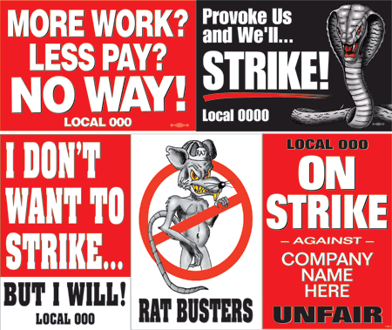
Chapter 8
Strike – Union workers banding together to stop working until their needs are met
Picket – A parade in front of the employer’s business carrying signs about the dispute
Boycott – A mass refusal to buy products from targeted employers or companies

Slide 4

Chapter 8
Lockout – A refusal to let the employees work until management demands are met
Company Union – A union organized, supported or run by employers – to head off efforts by others to organize workers
Great Depression – The greatest period of economic decline and stagnation in United States History – Began with the stock market crash in 1929

Slide 5

Chapter 8
Right-to-work Law – a state law making it illegal to force workers to join a union as a condition of employment
AFL – American Federation of Labor
CIO – Committee for Industrial Organization
Independent Unions – Unions that do not belong to the AFL-CIO

Slide 6
Chapter 8
Closed Shop – A situation in which the employer agrees to hire only union members
Union shop – An employment situation where workers do not have to belong to the union to be hired, but must join soon after and remain a member for as long as they keep their jobs
Modified Union Shop – Workers do not have to belong to a union to be hired and cannot be made to join one to keep their jobs
Agency Shop – An agreement that does not require a worker to join a union as a condition to get or keep their job

Slide 7

Chapter 8
Grievance Procedure – A provision for resolving issues that may come up later
Mediation – The process of bringing in a neutral third person to help settle a dispute
Arbitration – A process in which both sides agree to place their differences before a third party whose decision will be accepted as final

Slide 8
Warm Up
What is arbitration?
What is a Grievance Procedure?
What is the Right-to-Work Law?
What’s the difference between a strike and a lockout?
What is the civilian labor force and what statistic does it help determine?
Is it easy or difficult to establish worker’s rights and labor unions in a country? Explain
CEQ: What were the Presidential Primary results two nights ago?

Slide 9
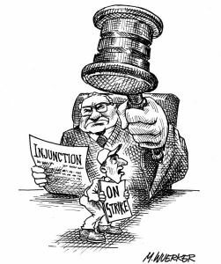
Chapter 8
Fact-Finding – An agreement between union and management to have a neutral third party collect facts about a dispute and present nonbinding recommendations
Injunction – A court order not to act
Seizure – A temporary takeover of operations to allow the government to negotiate with the union

Slide 10

Chapter 8
Unskilled Labor – Digging ditches, picking fruit, mopping floors, etc.
Semiskilled Labor – Workers with enough mechanical abilities and skills to operate machines that require a minimum amount of training
Ex) Floor polisher
Skilled Labor – Workers who are able to operate complex equipment and can perform their tasks with little supervision
Ex) Carpenter

Slide 11
Warm Up
What is an injunction?
What is unskilled, semiskilled and skilled labor? Give an example of each.
What is seizure in regards to the federal government? What is a famous example of this stemming from the 1980’s?

Slide 12
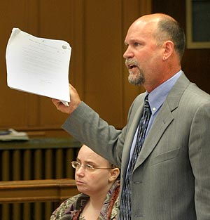

Chapter 8
Professional Labor – Those individuals with the highest level of knowledge based education and managerial skills
Noncompeting labor grades – Broad categories of labor that do not directly compete with one another because of experience, training, education, and other human capital investments

Slide 13
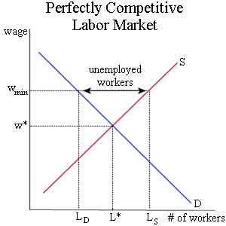
Chapter 8
Wage Rate – A standard amount of pay given for work performed
Traditional theory of wage determination – The supply and demand for a worker’s skills and services determine the wage or salary
Equilibrium Wage Rate – Wage rate that leaves neither a surplus nor a shortage in the labor market

Slide 14
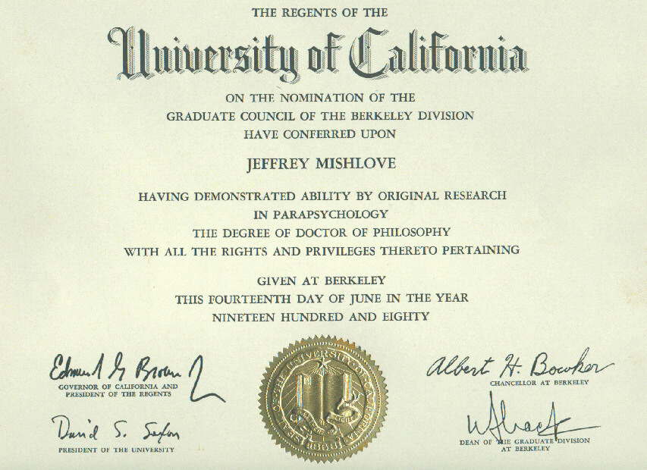
Chapter 8
Theory of Negotiated Wages – Organized labor’s bargaining strength is a factor that helps determine wages
Seniority – The length of time a person has been on the job
Signaling Theory – Employers are willing to pay more for people with certificates, diplomas, degrees, and other indicators or “signals” of superior ability

Slide 15
Warm Up
Did you commit to a college over Spring Break? Where?
Are you up to date on your Stock Market Project?
What is arbitration?
What is a closed shop?
What is the Right-to-Work Law?
What’s the difference between a strike and a lockout?
What is skilled labor?
What is professional labor?
CEQ: What did the largest document leak in human history simply referred to as the “Panama Papers” reveal (11.5 million documents)?
Notes:
Putin – $2 billion
Iceland, David Cameron, etc.
Unaoil corrupt and exploiting middle east
IMF deal with Greece - disaster

Slide 16

Chapter 8
Labor Mobility – The ability and willingness of workers to relocate in markets where wages are higher
Giveback – A wage, fringe benefit, or work rule given up when a labor contract is renegotiated
Two-Tier Wage System – A system that keeps high wages for current workers, but has much lower wage for newly hired workers

Slide 17

Chapter 8
Glass Ceiling – An invisible barrier that obstructs their advancement up the corporate ladder
Comparable Worth – Principle stating that people should receive equal pay for work that is different from, but just as demanding as, other types of work
Set-Aside Contract – Guaranteed contract reserved exclusively for a targeted group

Slide 18
Chapter 8
Part-Time Workers – Workers who regularly work fewer than 30 hours per week
Account for 1 out of 5 jobs in US
Minimum Wage – The lowest wage that can be paid by law to most workers
Set in 1939 at $.25/hour
Current Dollars – Dollars not adjusted for inflation
Real or Constant Dollars – Dollars that are adjusted to reflect inflation
Base Year – A year that serves for comparison of all other years

Slide 19
All Content Created by DJ Cook

